Slide 1
Sorting
Data Structures and Algorithms
Nanjing University, Fall 2024
郑朝栋

Slide 2
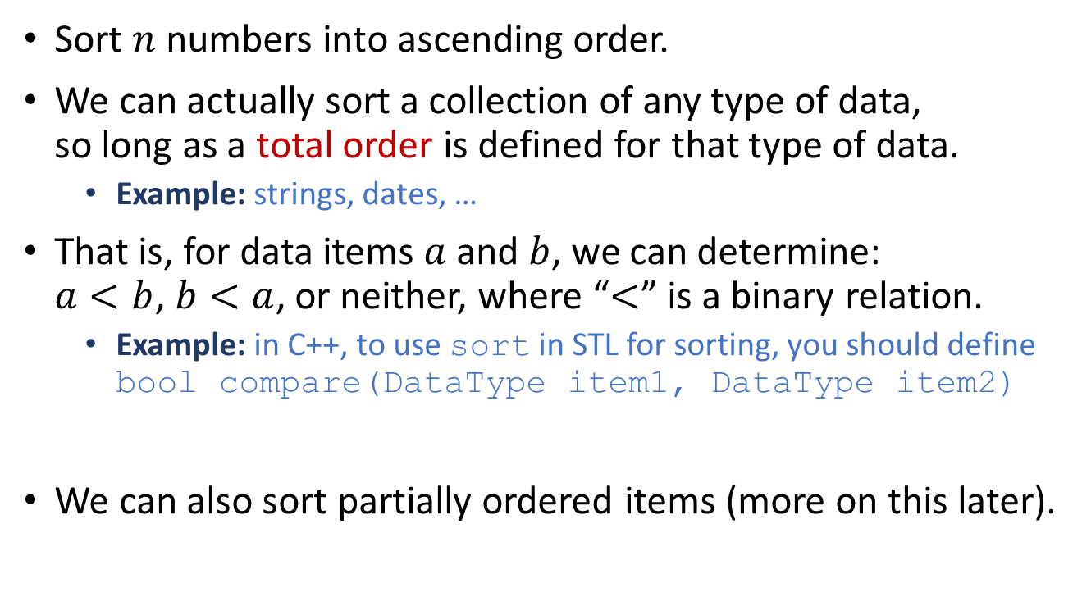
The Sorting Problem
Sort $n$ numbers into ascending order.
We can actually sort a collection of any type of data, so long as a total order is defined for that type of data.
Example: strings, dates, …
That is, for data items $a$ and $b$, we can determine: $a<b$, $b<a$, or neither, where “$<$” is a binary relation.
Example: in C++, to use sort in STL for sorting, you should define bool compare(DataType item1, DataType item2)
We can also sort partially ordered items (more on this later).

Slide 3
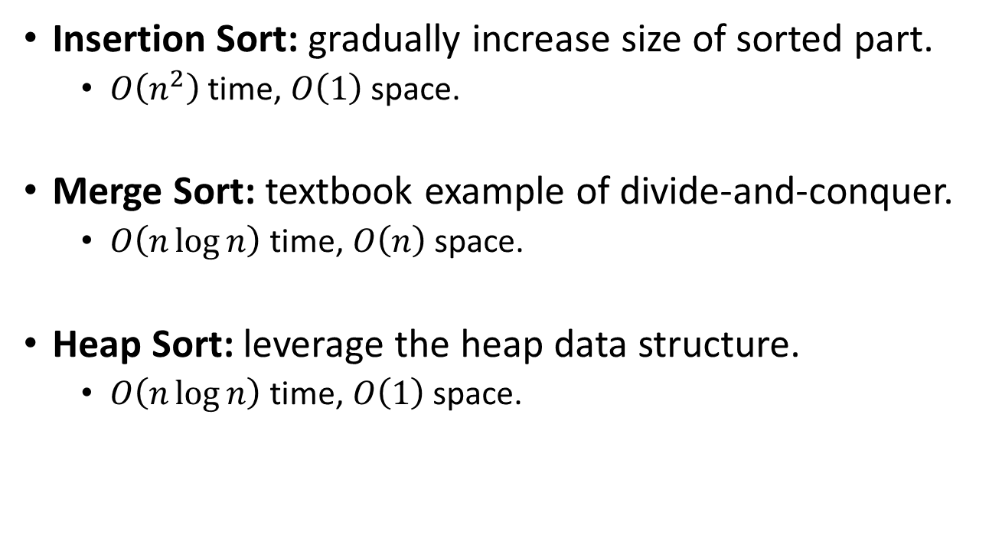
Sorting algorithms till now
Insertion Sort: gradually increase size of sorted part.
$O\left(n^{2}\right)$ time, $O\left(1\right)$ space.
Merge Sort: textbook example of divide-and-conquer.
$O\left(n\log{n}\right)$ time, $O\left(n\right)$ space.
Heap Sort: leverage the heap data structure.
$O\left(n\log{n}\right)$ time, $O\left(1\right)$ space.

Slide 4
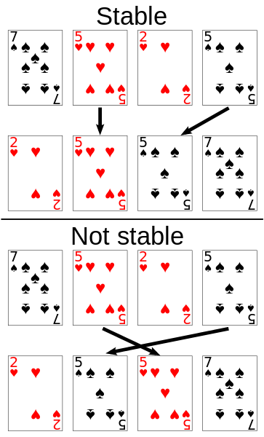

Characteristics of sorting algorithms
In-place: a sorting algorithm is in-place if $O(1)$ extra space is needed beyond input.
Stability: a sorting algorithm is stable if numbers with the same value (i.e., items that are “$=$”) appear in the output array in the same order as they do in the input array.

Slide 5
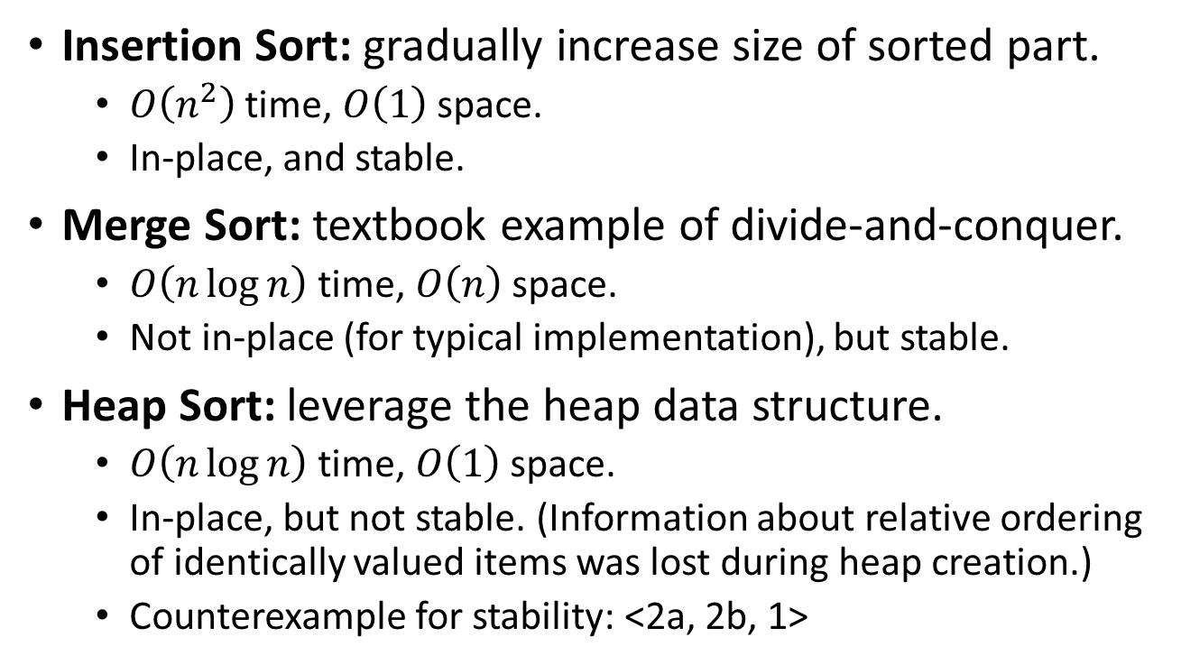
Sorting algorithms till now
Insertion Sort: gradually increase size of sorted part.
$O\left(n^{2}\right)$ time, $O\left(1\right)$ space.
In-place, and stable.
Merge Sort: textbook example of divide-and-conquer.
$O\left(n\log{n}\right)$ time, $O\left(n\right)$ space.
Not in-place (for typical implementation), but stable.
Heap Sort: leverage the heap data structure.
$O\left(n\log{n}\right)$ time, $O\left(1\right)$ space.
In-place, but not stable. (Information about relative ordering of identically valued items was lost during heap creation.)
Counterexample for stability: <2a, 2b, 1>

Slide 6
The Selection Sort Algorithm
Basic idea: pick out minimum element from input, then recursively sort remaining elements, and finally concatenate the minimum element with sorted remaining elements.
SelectionSort(A):
for (i=1 to A.length-1)
minIdx = i
for (j=i+1 to A.length)
if (A[j]<A[minIdx])
minIdx=j
Swap(i,minIdx)
SelectionSortRec(A):
if (|A|==1)
return A
else
min = GetMinElement(A)
A’ = RemoveElement(A,min)
return Concatenate(min,SelectSortionRec(A’))

Slide 7
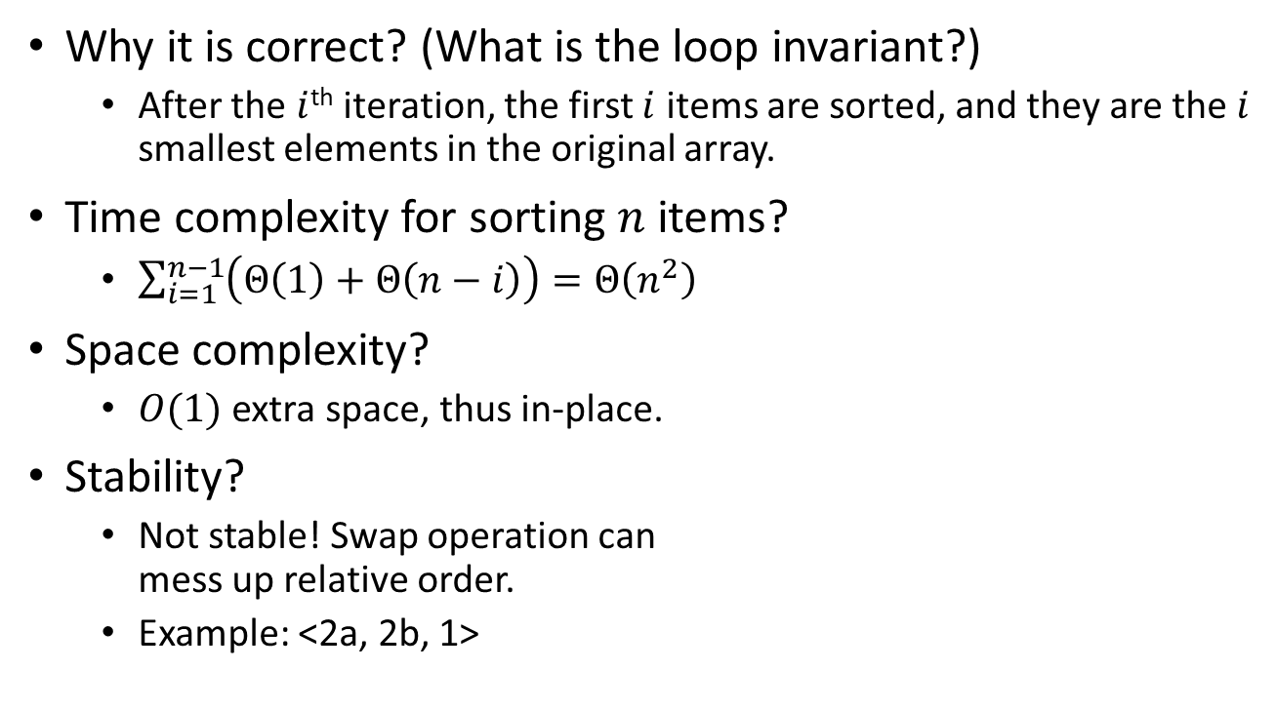
Analysis of SelectionSort
Why it is correct? (What is the loop invariant?)
After the $i$^{th} iteration, the first $i$ items are sorted, and they are the $i$ smallest elements in the original array.
Time complexity for sorting $n$ items?
$\sum_{i=1}^{n−1}{\left(Θ\left(1\right)+Θ\left(n−i\right)\right)}=Θ\left(n^{2}\right)$
Space complexity?
$O(1)$ extra space, thus in-place.
Stability?
Not stable! Swap operation can mess up relative order.
Example: <2a, 2b, 1>
SelectionSort(A):
for (i=1 to A.length-1)
minIdx = i
for (j=i+1 to A.length)
if (A[j]<A[minIdx])
minIdx=j
Swap(i,minIdx)

Slide 8

Before we move on…
SelectionSort(A):
for (i=1 to A.length-1)
minIdx = i
for (j=i+1 to A.length)
if (A[j]<A[minIdx])
minIdx=j
Swap(i,minIdx)
SelectionSortRec(A):
if (|A|==1)
return A
else
min = GetMinElement(A)
A’ = RemoveElement(A,min)
return Concatenate(min,SelectSortionRec(A’))
SelectionSortRec(A):
if (|A|==1)
return A
else
max = GetMaxElement(A)
A’ = RemoveElement(A,max)
return Concatenate(SelectSortionRec(A’),max)
What if $A$ is organized as a heap?
This framework leads to the faster HeapSort algorithm.

Slide 9
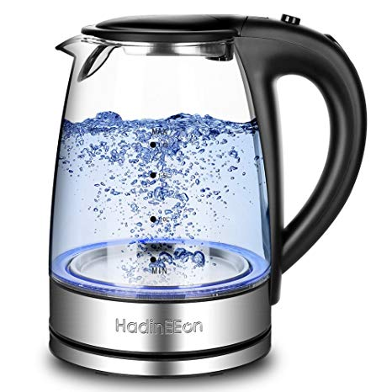
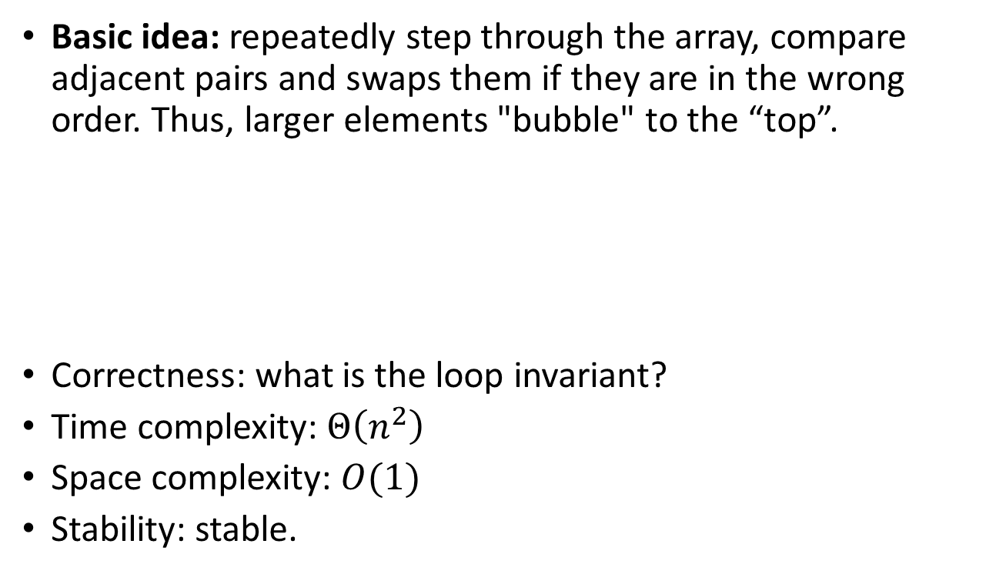
The Bubble Sort Algorithm
Basic idea: repeatedly step through the array, compare adjacent pairs and swaps them if they are in the wrong order. Thus, larger elements "bubble" to the “top”.
Correctness: what is the loop invariant?
Time complexity: $Θ\left(n^{2}\right)$
Space complexity: $O(1)$
Stability: stable.
BubbleSort(A):
for (i=A.length downto 2)
for (j=1 to i-1)
if (A[j]>A[j+1])
Swap(A[j],A[j+1])

Slide 10
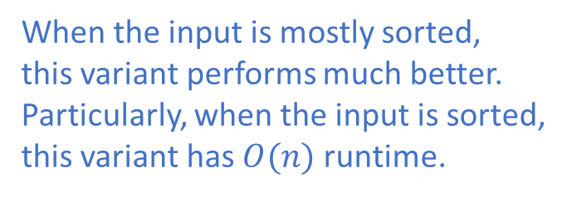
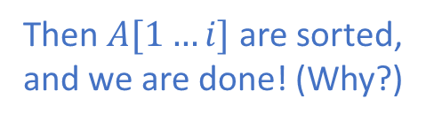
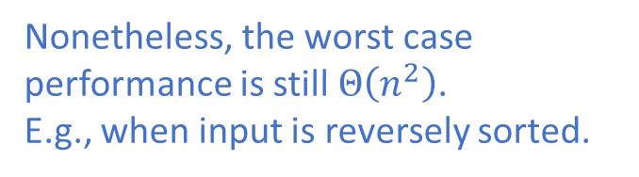
Improving BubbleSort
BubbleSort(A):
for (i=A.length downto 2)
for (j=1 to i-1)
if (A[j]>A[j+1])
Swap(A[j],A[j+1])
What if in one iteration we never swap data items?
Then $A[1…i]$ are sorted, and we are done! (Why?)
BubbleSortImproved(A):
n=A.length
repeat
swapped=false
for (j=1 to n-1)
if (A[j]>A[j+1])
Swap(A[j],A[j+1])
swapped=true
n=n-1
until (swapped==false)
When the input is mostly sorted, this variant performs much better.
Particularly, when the input is sorted, this variant has $O(n)$ runtime.
Q: Other algorithms that also have this property?
A: such as InsertionSort.
Nonetheless, the worst case performance is still $Θ\left(n^{2}\right)$.
E.g., when input is reversely sorted.

Slide 11

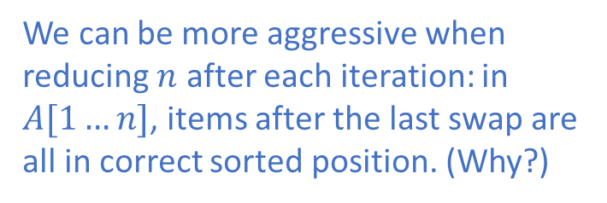

Improving BubbleSort
BubbleSortImproved(A):
n=A.length
repeat
swapped=false
for (j=1 to n-1)
if (A[j]>A[j+1])
Swap(A[j],A[j+1])
swapped=true
n=n-1
until (swapped==false)
Can we do better?
We can be more aggressive when reducing $n$ after each iteration: in $A[1…n]$, items after the last swap are all in correct sorted position. (Why?)
$$n=5$$
3
2
1
8
9
12
15
BubbleSortImprovedAgain(A):
n=A.length
repeat
lastSwapIdx=-1
for (j=1 to n-1)
if (A[j]>A[j+1])
Swap(A[j],A[j+1])
lastSwapIdx=j+1
n=lastSwapIdx-1
until (n<=1)
3
2
1
8
9
12
15
Swap!
2
3
1
8
9
12
15
Swap!
2
1
3
8
9
12
15
No swap!
2
1
3
8
9
12
15
No swap!
2
1
3
8
9
12
15
$$n=2$$

Slide 12
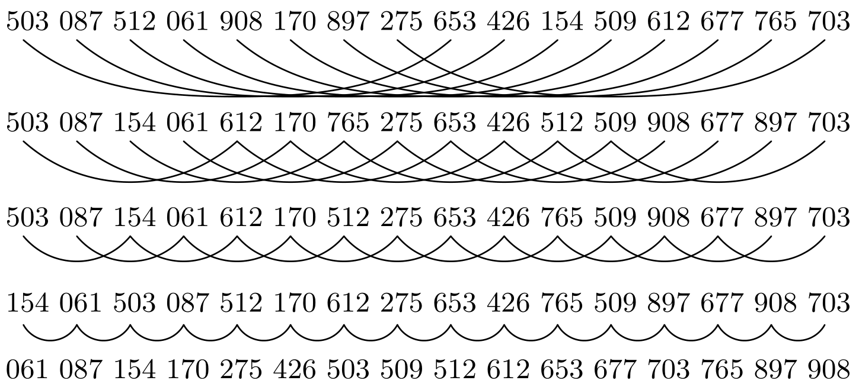
*Shell’s method for sorting
Let’s first see an example of ShellSort: sort 16 integers.
[Pass 1] Group elements of distance 8 together, end up with eight groups each of size two. Sort these groups individually.
[Pass 2] Group elements of distance 4 together, end up with four groups each of size four. Sort these groups individually.
[Pass 3] Group elements of distance 2 together, end up with two groups each of size eight. Sort these groups individually.
[Pass 4] Group elements of distance 1, this is just an ordinary sort on all elements.

Slide 13
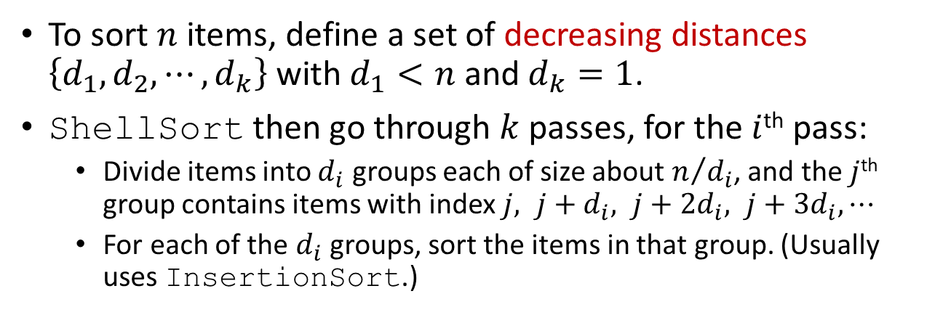
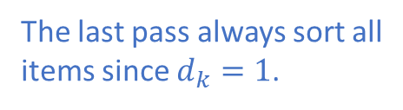
General framework of ShellSort
To sort $n$ items, define a set of decreasing distances $\left\{d_{1},d_{2},⋯,d_{k}\right\}$ with $d_{1}<n$ and $d_{k}=1$.
ShellSort then go through $k$ passes, for the $i$^{th} pass:
Divide items into $d_{i}$ groups each of size about $n/{d_{i}}$, and the $j$^{th} group contains items with index $j, j+d_{i}, j+2d_{i}, j+3d_{i},⋯$
For each of the $d_{i}$ groups, sort the items in that group. (Usually uses InsertionSort.)
Why ShellSort is correct?
The last pass always sort all items since $d_{k}=1$.
But then why bother earlier passes?!

Slide 14
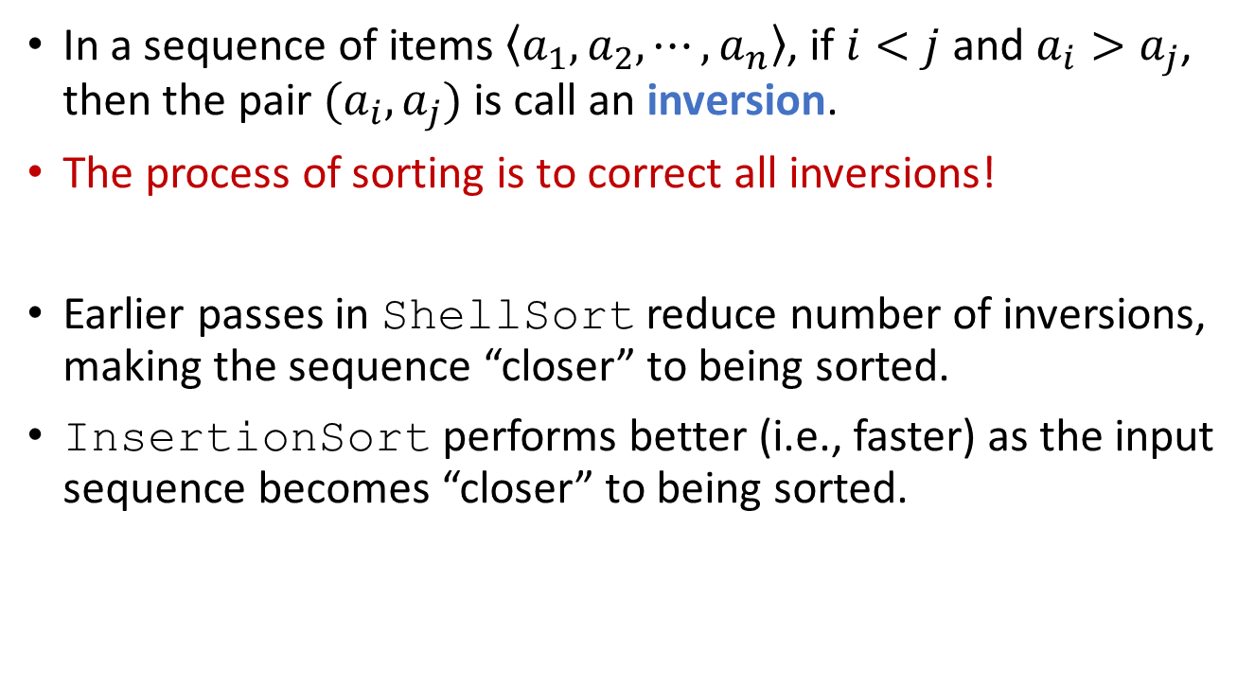
Motivation of ShellSort
In a sequence of items $\left\langle a_{1},a_{2},⋯,a_{n}\right\rangle$, if $i<j$ and $a_{i}>a_{j}$, then the pair $(a_{i},a_{j})$ is call an inversion.
The process of sorting is to correct all inversions!
Earlier passes in ShellSort reduce number of inversions, making the sequence “closer” to being sorted.
InsertionSort performs better (i.e., faster) as the input sequence becomes “closer” to being sorted.

Slide 15
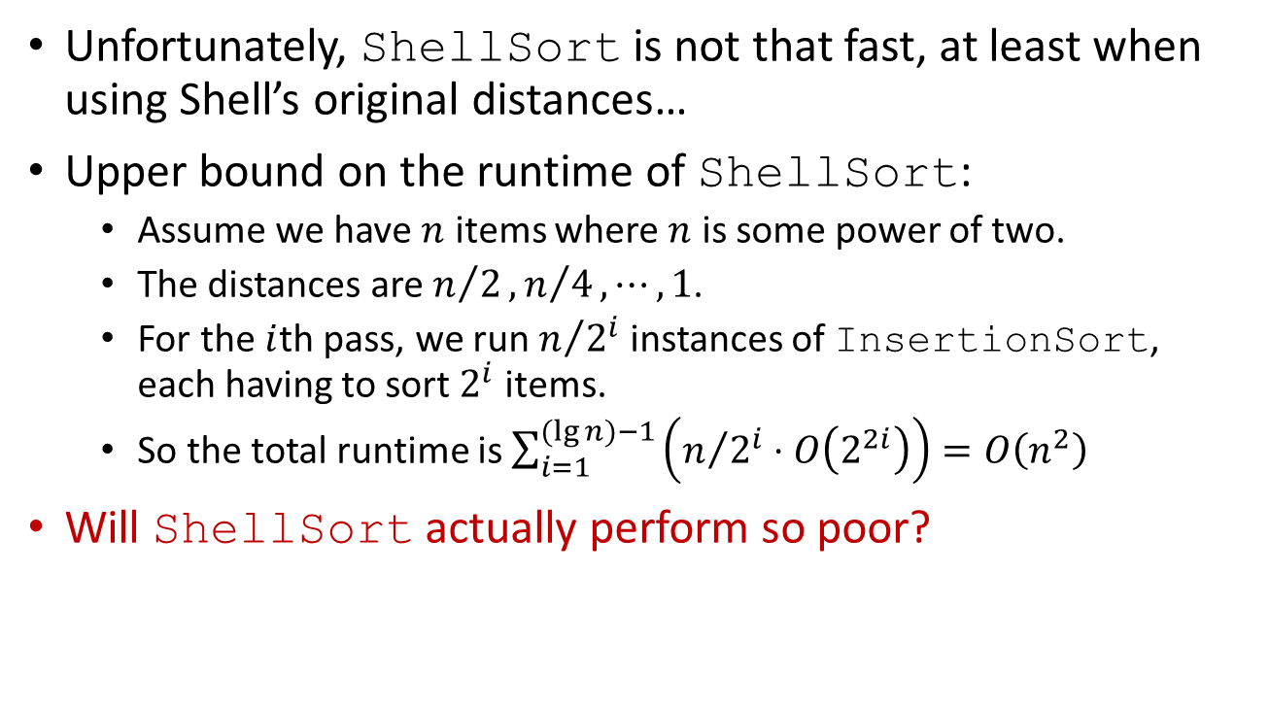
Ideal versus Reality
Unfortunately, ShellSort is not that fast, at least when using Shell’s original distances…
Upper bound on the runtime of ShellSort:
Assume we have $n$ items where $n$ is some power of two.
The distances are $n/2,n/4,⋯,1$.
For the $i$th pass, we run $n/{2^{i}}$ instances of InsertionSort, each having to sort $2^{i}$ items.
So the total runtime is $\sum_{i=1}^{(lg{n})−1}{\left(n/{2^{i}}⋅O\left(2^{2i}\right)\right)}=O\left(n^{2}\right)$
Will ShellSort actually perform so poor?

Slide 16
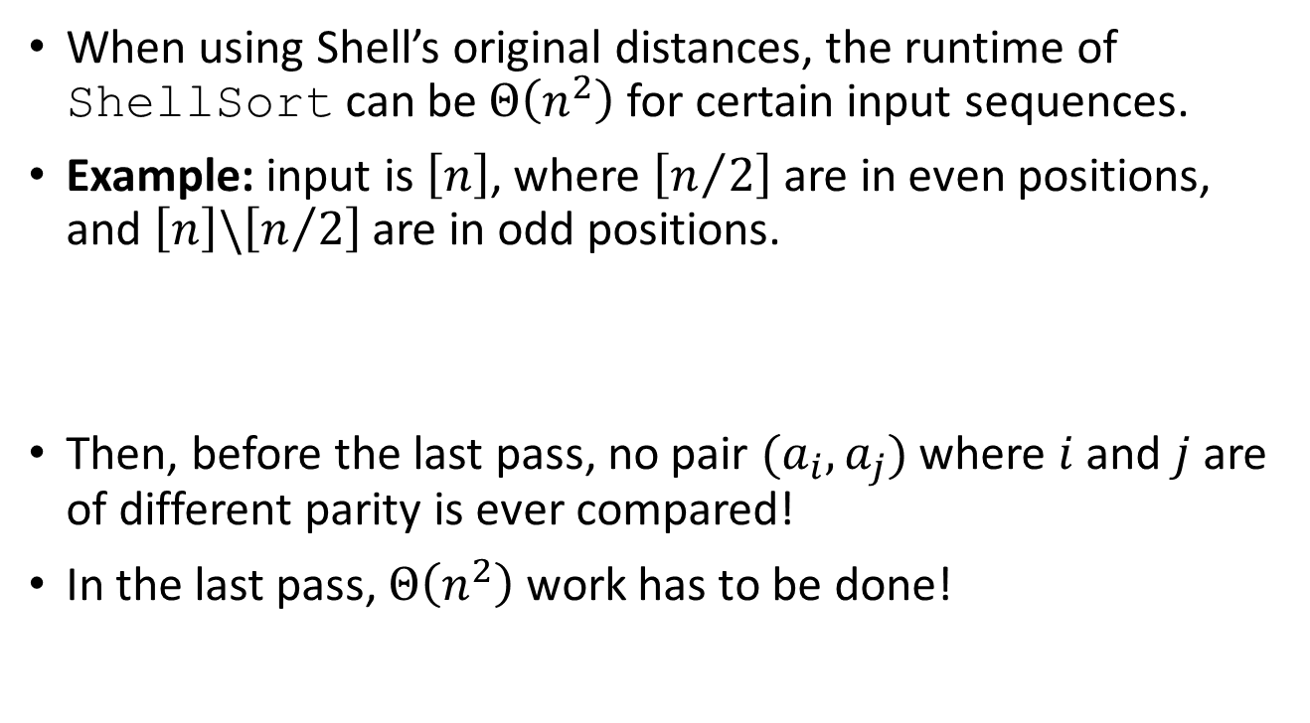
ShellSort can be slow!
When using Shell’s original distances, the runtime of ShellSort can be $Θ\left(n^{2}\right)$ for certain input sequences.
Example: input is $\left[n\right]$, where $\left[n/2\right]$ are in even positions, and $\left[n\right]\backslash \left[n/2\right]$ are in odd positions.
Then, before the last pass, no pair $(a_{i},a_{j})$ where $i$ and $j$ are of different parity is ever compared!
In the last pass, $Θ\left(n^{2}\right)$ work has to be done!

Slide 17
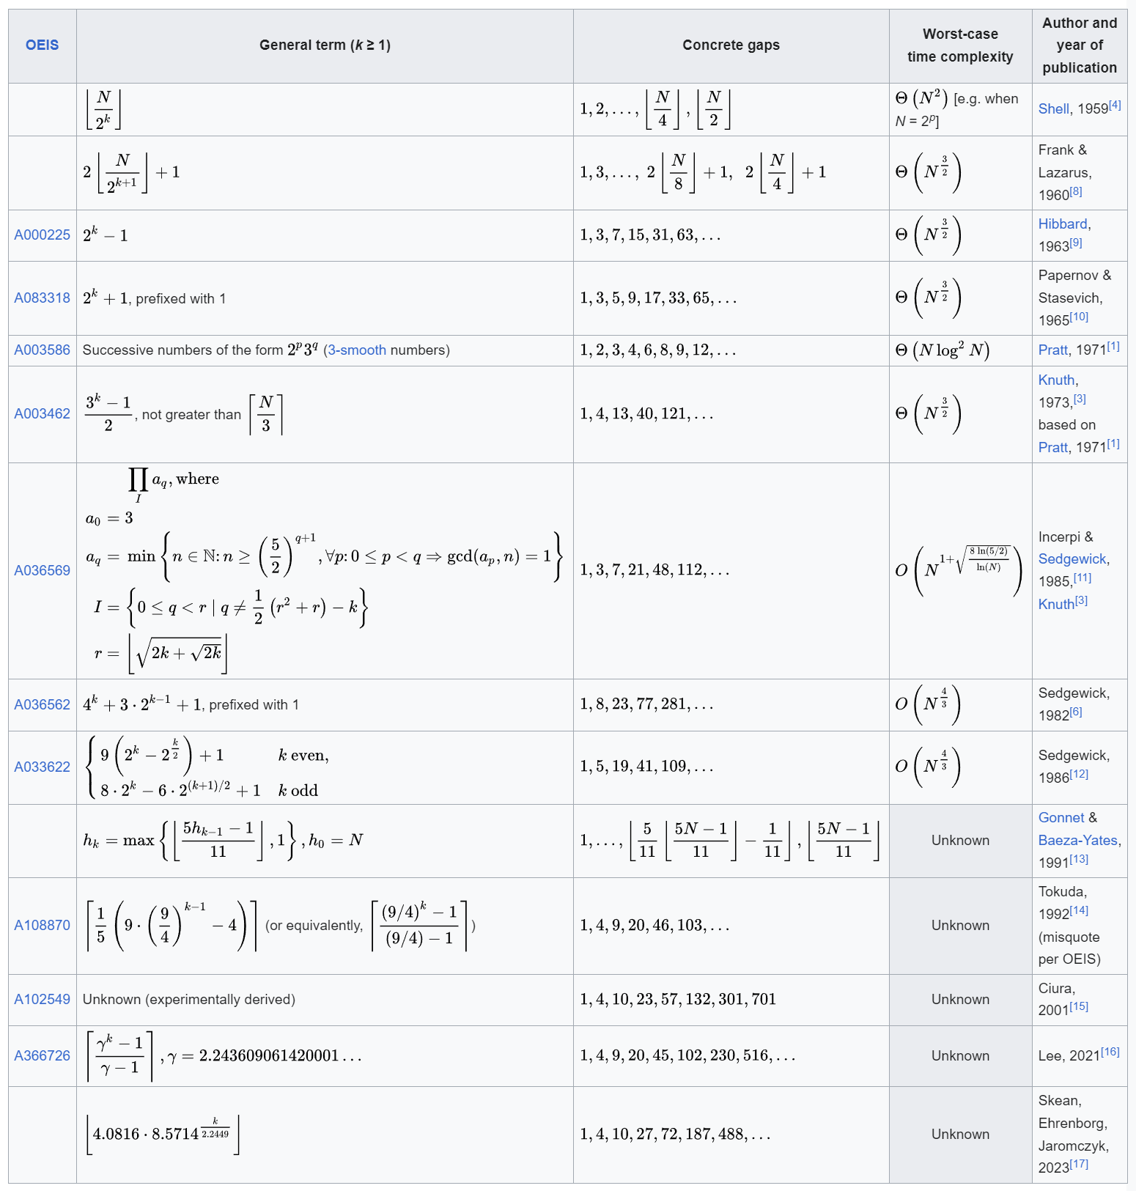
Choice of distances matters, a lot!

Slide 18
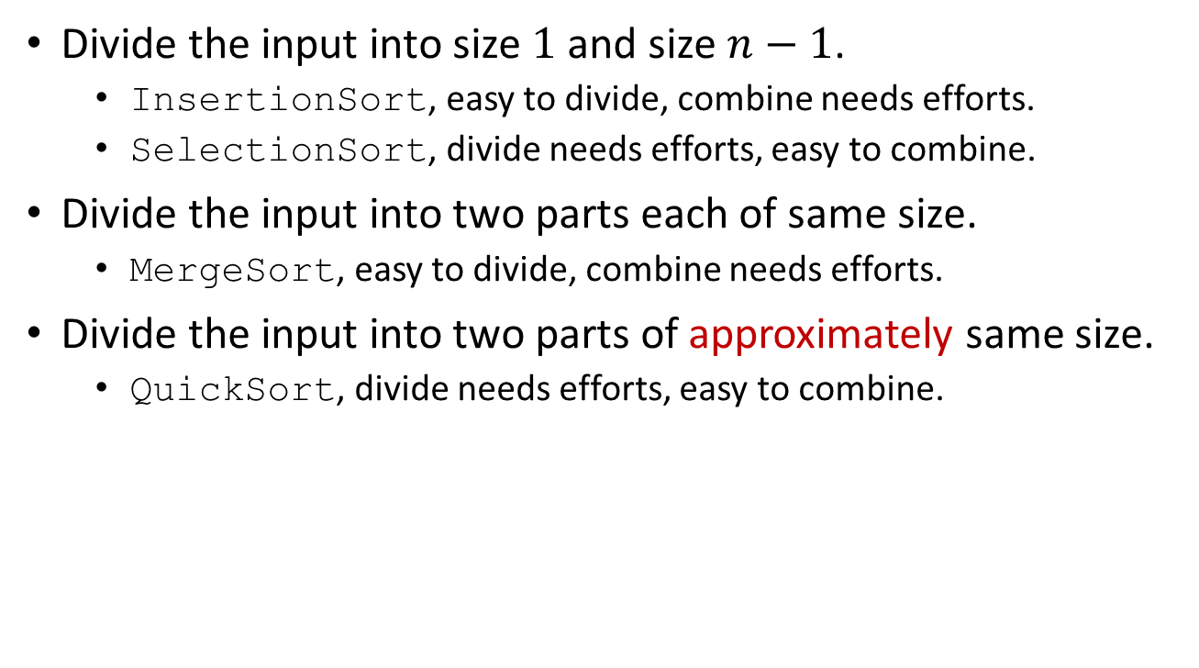
Divide-and-Conquer: A unified view for many sorting algs.
Divide the input into size $1$ and size $n−1$.
InsertionSort, easy to divide, combine needs efforts.
SelectionSort, divide needs efforts, easy to combine.
Divide the input into two parts each of same size.
MergeSort, easy to divide, combine needs efforts.
Divide the input into two parts of approximately same size.
QuickSort, divide needs efforts, easy to combine.
Divide problem into subproblems.
Conquer subproblems recursively.
Combine solutions of subproblems.

Slide 19

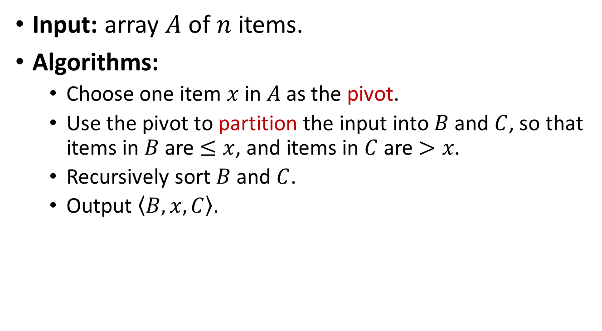
The QuickSort Algorithm
QuickSortAbs(A):
x = GetPivot(A)
<B,C> = Partition(A,x)
QuickSortAbs(B)
QuickSortAbs(C)
return Concatenate(B,x,C)
Input: array $A$ of $n$ items.
Algorithms:
Choose one item $x$ in $A$as the pivot.
Use the pivot to partition the input into $B$ and $C$, so that items in $B$ are $≤x$, and items in $C$ are $>x$.
Recursively sort $B$ and $C$.
Output $\left\langle B,x,C\right\rangle$.
C. A. R. Hoare
Recipient of the Turing Award in 1980 for "fundamental contributions to the definition and design of programming languages“.

Slide 20
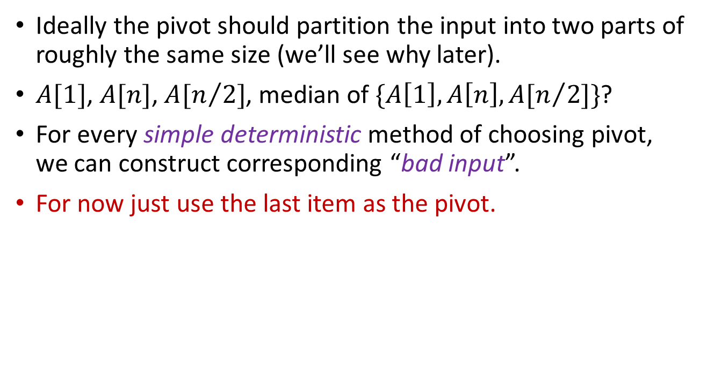
Choosing the pivot
Ideally the pivot should partition the input into two parts of roughly the same size (we’ll see why later).
$A[1]$, $A[n]$, $A[n/2]$, median of $\{A\left[1\right],A\left[n\right],A[n/2]\}$?
For every simple deterministic method of choosing pivot, we can construct corresponding “bad input”.
For now just use the last item as the pivot.

Slide 21
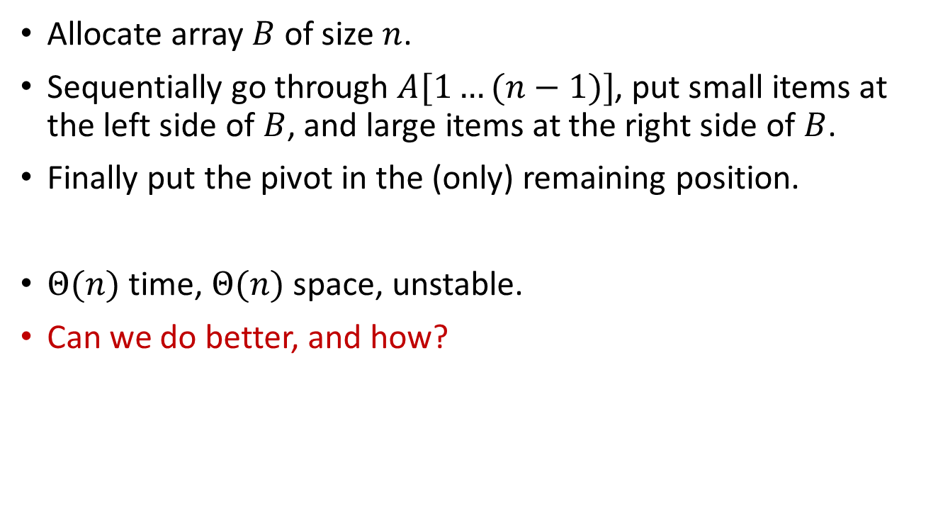
The Partition Procedure
Allocate array $B$ of size $n$.
Sequentially go through $A[1…(n−1)]$, put small items at the left side of $B$, and large items at the right side of $B$.
Finally put the pivot in the (only) remaining position.
$Θ(n)$ time, $Θ(n)$ space, unstable.
Can we do better, and how?
Partition(A):
x = A[n], l = 1, r = n
for (i=1 to n-1)
if (A[i]<=x)
B[l] = A[i]
l++
else
B[r] = A[i]
r--
B[l]=x
return <B,l>

Slide 22
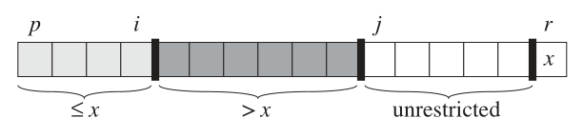
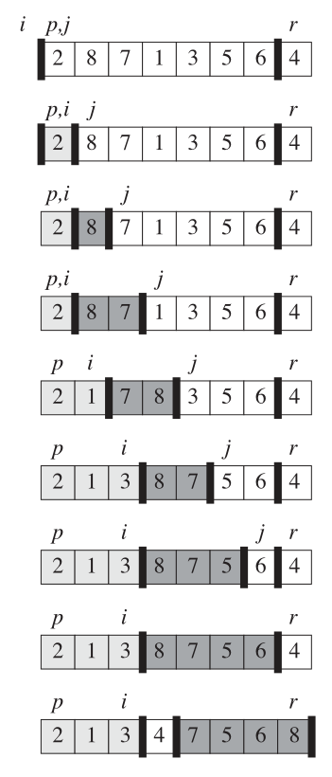

In-place Partition
Basic Idea: sequentially go through $A$, use swap operations to move small items to the left part of $A$; thus the right part of $A$ naturally contains large items.
InplacePartition(A, p, r):
x = A[r], i=p-1
for (j=p to r-1)
if (A[j]<=x)
i=i+1
Swap(A[i],A[j])
Swap(A[i+1],A[r])
return i+1

Slide 23








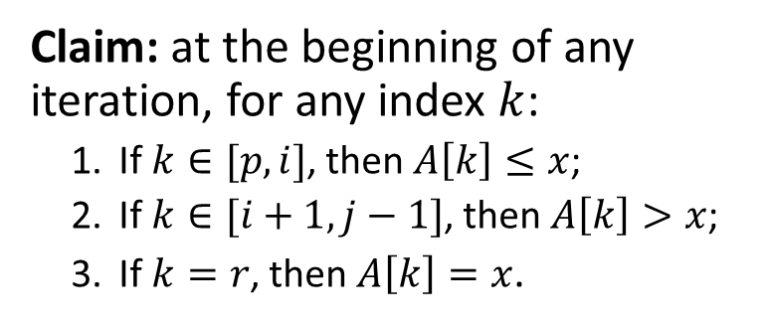


















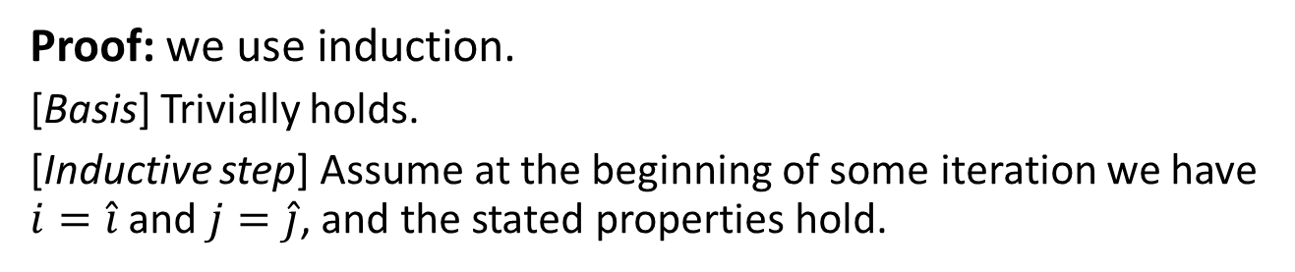












InplacePartition(A, p, r):
x = A[r], i=p-1
for (j=p to r-1)
if (A[j]<=x)
i=i+1
Swap(A[i],A[j])
Swap(A[i+1],A[r])
return i+1
Claim: at the beginning of any iteration, for any index $k$:
If $k∈[p,i]$, then $A\left[k\right]≤x$;
If $k∈[i+1,j−1]$, then $A\left[k\right]>x$;
If $k=r$, then $A\left[k\right]=x$.
$$p$$
$$\hat{i}$$
$$\hat{j}$$
$$r$$
$$i$$
$$p,j$$
$$r$$
Proof: we use induction.
[Basis] Trivially holds.
[Inductive step] Assume at the beginning of some iteration we have $i=\hat{i}$ and $j=\hat{j}$, and the stated properties hold.
$$y$$
$$x$$
$$x$$
In this iteration:
$$p$$
$$i=\hat{i}$$
$$j=\hat{j}$$
$$r$$
$$p$$
$$i=\hat{i}$$
$$j=\hat{j}$$
$$r$$
$$y$$
$$a$$
$$x$$
or
$$y$$
$$z$$
$$x$$
$$p$$
$$i$$
$$j$$
$$r$$
$$p$$
$$i$$
$$j$$
$$r$$
$$a$$
$$y$$
$$x$$
$$y$$
$$z$$
$$x$$

Slide 24








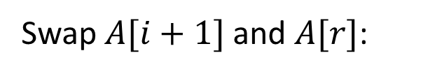
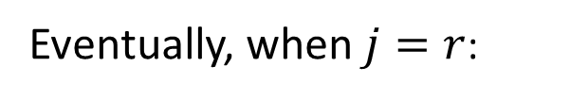


InplacePartition(A, p, r):
x = A[r], i=p-1
for (j=p to r-1)
if (A[j]<=x)
i=i+1
Swap(A[i],A[j])
Swap(A[i+1],A[r])
return i+1
Claim: at the beginning of any iteration, for any index $k$:
If $k∈[p,i]$, then $A\left[k\right]≤x$;
If $k∈[i+1,j−1]$, then $A\left[k\right]>x$;
If $k=r$, then $A\left[k\right]=x$.
Eventually, when $j=r$:
$$p$$
$$i$$
$$j,r$$
$$y$$
$$x$$
Swap $A[i+1]$ and $A[r]$:
$$p$$
$$i$$
$$j,r$$
$$x$$
$$y$$
During execution, we only swap items, no addition/deletion.
So InplacePartition correctly partitions the input array.

Slide 25
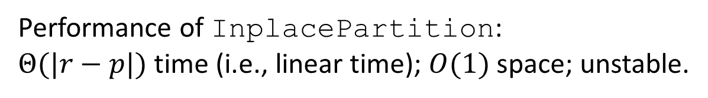
The QuickSort Algorithm
InplacePartition(A, p, r):
x = A[r], i=p-1
for (j=p to r-1)
if (A[j]<=x)
i=i+1
Swap(A[i],A[j])
Swap(A[i+1],A[r])
return i+1
QuickSort(A, p, r):
if (p<r)
q = InplacePartition(A,p,r)
QuickSort(A,p,q-1)
QuickSort(A,q+1,r)
QuickSortAbs(A):
x = GetPivot(A)
<B,C> = Partition(A,x)
QuickSortAbs(B)
QuickSortAbs(C)
return Concatenate(B,x,C)
Performance of InplacePartition:
$Θ(|r−p|)$ time (i.e., linear time); $O(1)$ space; unstable.
Performance of QuickSort?

Slide 26
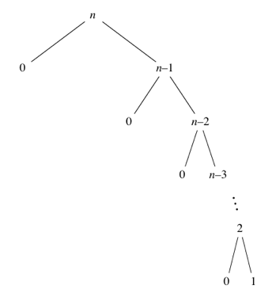
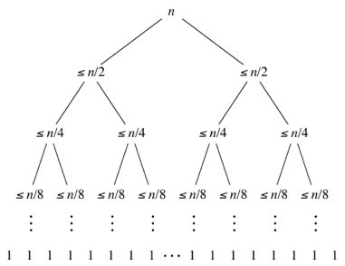

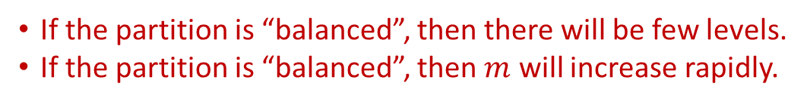


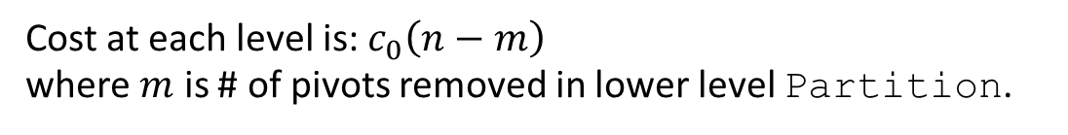







$$n$$
$$≈c_{0}n$$
$$n_{1,1}$$
$$\left(n−1\right)−n_{1,1}=n_{1,2}$$
$$≈c_{0}n$$
$$n_{2,1}$$
$$\left(n_{1,1}−1\right)−n_{2,1}=n_{2,2}$$
$$n_{2,3}$$
$$\left(n_{1,2}−1\right)−n_{2,3}=n_{2,4}$$
$$≈c_{0}n$$
……
Cost at each level is: $c_{0}\left(n−m\right)$ where $m$ is # of pivots removed in lower level Partition.
Worst Case
Best Case
If the partition is “balanced”, then there will be few levels.
If the partition is “balanced”, then $m$ will increase rapidly.

Slide 27

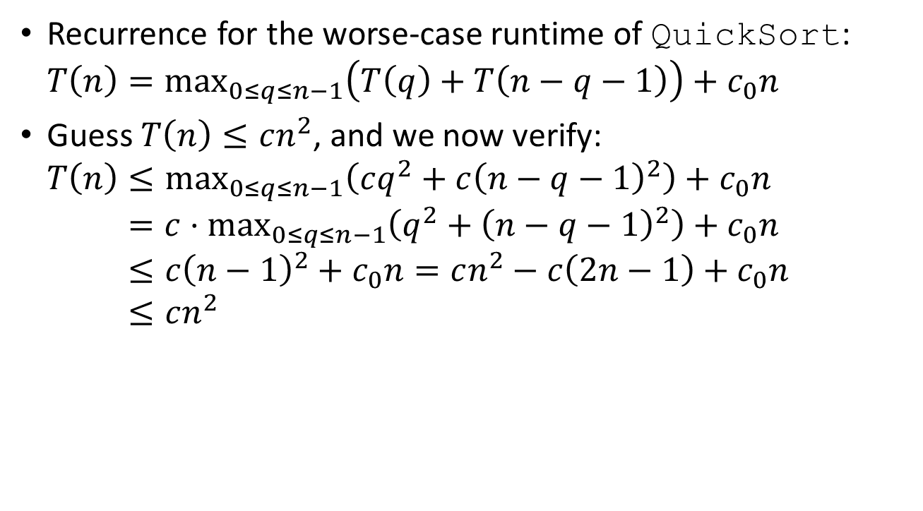
Performance of QuickSort
Recurrence for the worse-case runtime of QuickSort: $T\left(n\right)=\max_{0≤q≤n−1}\left(T\left(q\right)+T\left(n−q−1\right)\right)+c_{0}n$
Guess $T\left(n\right)≤cn^{2}$, and we now verify: $T\left(n\right)≤\max_{0≤q≤n−1}\left(cq^{2}+c{\left(n−q−1\right)}^{2}\right)+c_{0}n$ $T\left(n\right)=c⋅\max_{0≤q≤n−1}\left(q^{2}+{\left(n−q−1\right)}^{2}\right)+c_{0}n$ $T\left(n\right)≤c{\left(n−1\right)}^{2}+c_{0}n=cn^{2}−c\left(2n−1\right)+c_{0}n$ $T\left(n\right)≤cn^{2}$
when $q=0$ or $q=n−1$
QuickSort(A, p, r):
if (p<r)
q = InplacePartition(A,p,r)
QuickSort(A,p,q-1)
QuickSort(A,q+1,r)

Slide 28
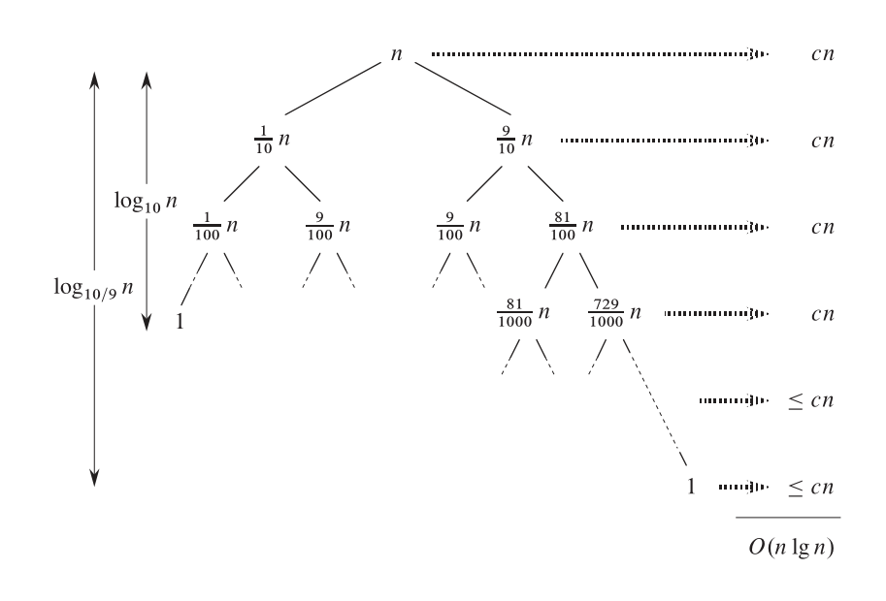

Performance of QuickSort
“Balanced” partition gives best case performance.
$T\left(n\right)≤T\left(n/2\right)+T\left(n/2\right)+Θ(n)$ implies $T\left(n\right)=O(n\log{n})$.
Partition does not need to be perfectly balanced, we only need each split to be constant proportionality.
$T\left(n\right)≤T\left(dn\right)+T\left(\left(1−d\right)n\right)+Θ(n)$ where $d=Θ(1)$.
QuickSort(A, p, r):
if (p<r)
q = InplacePartition(A,p,r)
QuickSort(A,p,q-1)
QuickSort(A,q+1,r)

Slide 29
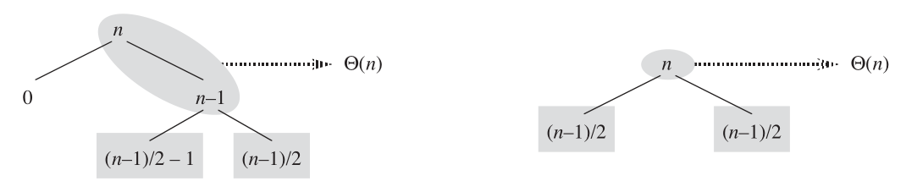
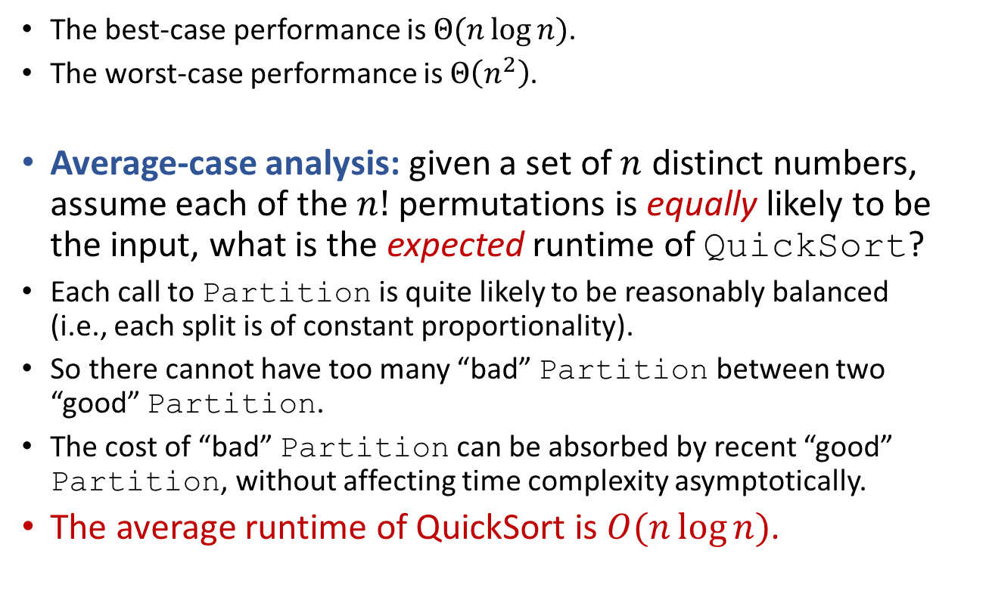
Performance of QuickSort
So how well does QuickSort perform in general?
The best-case performance is $Θ(n\log{n})$.
The worst-case performance is $Θ\left(n^{2}\right)$.
Average-case analysis: given a set of $n$ distinct numbers, assume each of the $n!$ permutations is equally likely to be the input, what is the expected runtime of QuickSort?
Each call to Partition is quite likely to be reasonably balanced (i.e., each split is of constant proportionality).
So there cannot have too many “bad” Partition between two “good” Partition.
The cost of “bad” Partition can be absorbed by recent “good” Partition, without affecting time complexity asymptotically.
The average runtime of QuickSort is $O(n\log{n})$.

Slide 30
Randomized QuickSort
RndQuickSort(A, p, r):
if (p<r)
i = Random(p,r)
Swap(A[r],A[i])
q = InplacePartition(A,p,r)
RndQuickSort(A,p,q-1)
RndQuickSort(A,q+1,r)
Picking “good” pivot is important for the performance, but how do we do it?
On choosing pivot: first, last, median of three, …?
Any simple deterministic mechanism could fail! (If the input is given by an “adversary” that knows the algorithm.)
Choose pivot (uniformly) at random!
Since the choice is randomly made, there is a good chance (constant probability) that we choose a “good” pivot.
The above claim holds even if the input is given by an “adversary” that knows the algorithm (but not the random bits the algorithm uses).

Slide 31
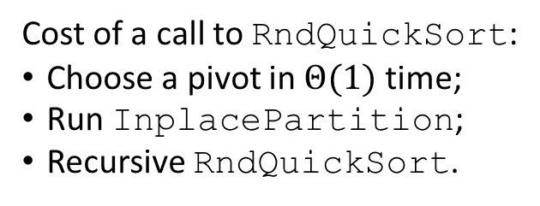
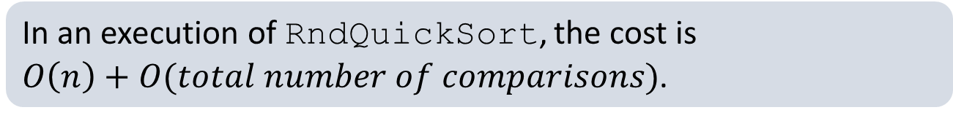
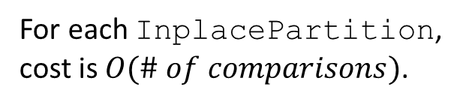
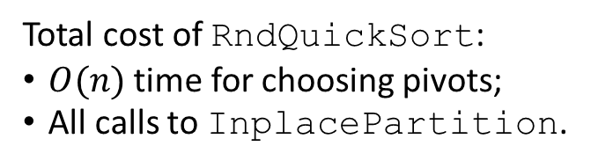
Performance of RndQuickSort
InplacePartition(A, p, r):
x = A[r], i=p-1
for (j=p to r-1)
if (A[j]<=x)
i=i+1
Swap(A[i],A[j])
Swap(A[i+1],A[r])
return i+1
RndQuickSort(A, p, r):
if (p<r)
i = Random(p,r)
Swap(A[r],A[i])
q = InplacePartition(A,p,r)
RndQuickSort(A,p,q-1)
RndQuickSort(A,q+1,r)
The expected runtime is $O(n\log{n})$, for any input distribution.
Cost of a call to RndQuickSort:
Choose a pivot in $Θ(1)$ time;
Run InplacePartition;
Recursive RndQuickSort.
Total cost of RndQuickSort:
$O(n)$ time for choosing pivots;
All calls to InplacePartition.
In an execution of RndQuickSort, the cost is $O\left(n\right)+O(total number of comparisons)$.
For each InplacePartition, cost is $O(\# of comparisons)$.
Each node can be pivot at most once!

Slide 32
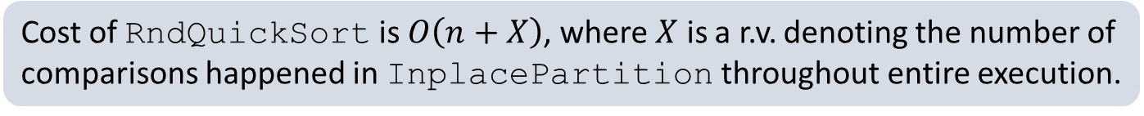
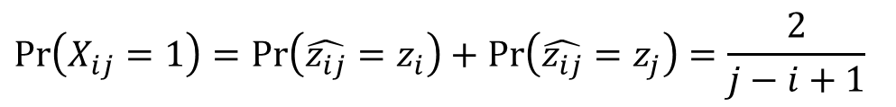
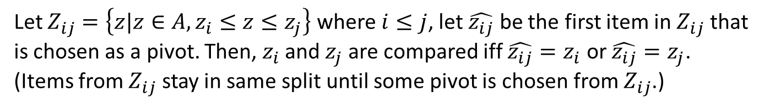
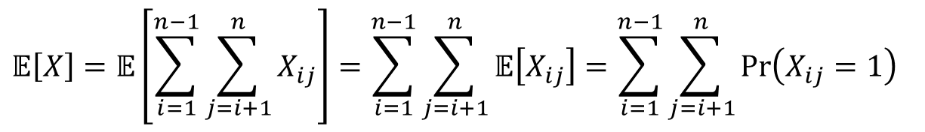
Cost of RndQuickSort is $O\left(n+X\right)$, where $X$ is a r.v. denoting the number of comparisons happened in InplacePartition throughout entire execution.
Each of pair of items is compared at most once!
(Items only compare with pivots, and each item can be the pivot at most once.)
Let $X_{ij}=I\{z_{i} is ever compared to z_{j}\}$, where $z_{i}$ is the item with rank $i$ in input.
$$𝔼\left[X\right]=𝔼\left[\sum_{i=1}^{n−1}{\sum_{j=i+1}^{n}{X_{ij}}}\right]=\sum_{i=1}^{n−1}{\sum_{j=i+1}^{n}{𝔼\left[X_{ij}\right]}}=\sum_{i=1}^{n−1}{\sum_{j=i+1}^{n}{\operatorname{Pr}\left(X_{ij}=1\right)}}$$
Let $Z_{ij}=\left\{z|z∈A,z_{i}≤z≤z_{j}\right\}$ where $i≤j$, let $\hat{z_{ij}}$ be the first item in $Z_{ij}$ that is chosen as a pivot. Then, $z_{i}$ and $z_{j}$ are compared iff $\hat{z_{ij}}=z_{i}$ or $\hat{z_{ij}}=z_{j}$.
(Items from $Z_{ij}$ stay in same split until some pivot is chosen from $Z_{ij}$.)
$$\operatorname{Pr}\left(X_{ij}=1\right)=\operatorname{Pr}\left(\hat{z_{ij}}=z_{i}\right)+\operatorname{Pr}\left(\hat{z_{ij}}=z_{j}\right)=\frac{2}{j−i+1}$$
$𝔼\left[X\right]=O(n\log{n})$, thus expected runtime of RndQuickSort is $O(n\log{n})$.
In fact, runtime of RndQuickSort is $O(n\log{n})$ with high probability!

Slide 33
A bit more on Quick Sort
What if there are many duplicates?
Maintain four regions as we go through the array.
End up with three regions (“<”, “=”, and “>”), and only recurse into two of them (“<” and “>”). Wow! Worst-cast becomes best-case!
Stop recursion once the array is too small.
Recursion has overhead, QuickSort is slow on small arrays.
Multiple pivots?
Early studies do not give promising results…
Dual-Pivot variant proposed by Yaroslavskiy in 2009 seems faster.
This variant is used in Java for sorting. (Since Java 7.)
“Average Case Analysis of Java 7's Dual Pivot Quicksort”. (Best Paper of ESA 2012)
< pivot
= pivot
In Progress
> pivot

Slide 34
Summary on Quick Sort
A widely-used efficient sorting algorithm.
Easy to understand! (divide-and-conquer…)
Moderately hard to implement correctly. (partition…)
Harder to analyze. (randomization…)
Challenging to optimize. (theory and practice…)

Slide 35

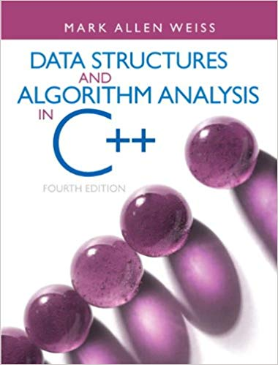

Reading
[CLRS] Ch.7, Appendix C (C.2-C.4) on probability theory
*On ShellSort:
[Weiss] Ch.7 (7.4)
[Deng] Ch.12 (12.3)
[TAOCP] Ch.5 (5.2.1 in vol.3)

